Slide 1
Graph Theory Basics
CME4422, I. Atakan KUBILAY, PhD.

Slide 2
Outline
Definitions I
Graph Definition
Eccentricity, Diameter, Radius
Periphery, Center
Graph Types
Directed\Undirected Graphs
Weighted\Non-weighted Graphs
Signed Graphs
Definitions II
Path
Eulerian Walk
Neighborhood
Connected/Disconnected Graphs
Bridge and Hub
Graph Representations
Adjacency Matrix
Adjacency List
Edge List
Incidence Matrix

Slide 3
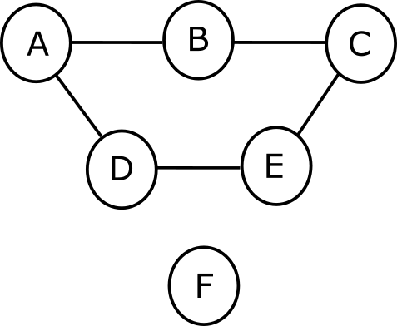
A Basic Graph: Graph1
Edge
Node
(Vertex)

Slide 4

Graph Definition
The set of Vertices(nodes) in a graph are given as:
$$V=\left\{v_{1},v_{2},⋯v_{n}\right\}$$
For our graph1 above $V=\left\{A,B,C,D,E,F\right\}$
The size n of a graph is denoted by $\left|V\right|$ and for graph1 $n=\left|V\right|=6$
The set of Edges in a graph are given as: $E=\left\{e_{1},e_{2},…,e_{n}\right\}$
The size m of a graph is denoted by $\left|E\right|$ and for graph1 $m=\left|E\right|=5$

Slide 5
Simple Graph
A simple graph has no loops.
At most one edge between the nodes.

Slide 6

Mathematical Notation
The mathematical notation for an undirected, unweighted graph is given by $G\left(V,E\right)$.
For graph1:
V = {A,B,C,D,E,F}
E = {AB,BC,CE,ED,DA}

Slide 7
Eccentricity, Diameter and Radius

Slide 8


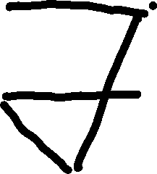





Eccentricity
Eccentricity is defined individually for every node in the graph.
It’s the maximum distance from the node to any other node.
$$e\left(V_{1}\right)=3$$
$$e\left(V_{2}\right)=2$$
$$e\left(V_{3}\right)=2$$
$$e\left(V_{4}\right)=2$$
$$e\left(V_{5}\right)=3$$

Slide 9

Diameter and Radius
Diameter and Radius are defined for the entire graph.
Diameter is the maximum eccentricity of the graph.
Radius is the minimum eccentricity of the graph.
$$e\left(V_{1}\right)=3$$
$$e\left(V_{2}\right)=2$$
$$e\left(V_{3}\right)=2$$
$$e\left(V_{4}\right)=2$$
$$e\left(V_{5}\right)=3$$
Diameter: 3
Radius: 2
Radius ≤ Diameter ≤ 2Radius

Slide 10
Periphery and Center

Slide 11



Periphery
If a node’s eccentricity is equal to the diameter of the graph, then it’s a peripheral node.
The set of all such nodes is the periphery of the graph.
Peripheral Node
$$e\left(V_{1}\right)=3$$
$$e\left(V_{2}\right)=2$$
$$e\left(V_{3}\right)=2$$
$$e\left(V_{4}\right)=2$$
$$e\left(V_{5}\right)=3$$
Peripheral Node
Periphery={V₁,V₅}

Slide 12

Center
If a node’s eccentricity is equal to the radius of the graph, then it’s a central node.
The set of all such nodes is the center of the graph.
$$e\left(V_{1}\right)=3$$
$$e\left(V_{2}\right)=2$$
$$e\left(V_{3}\right)=2$$
$$e\left(V_{4}\right)=2$$
$$e\left(V_{5}\right)=3$$
PCentral Nodes
Center={V₂,V₃,V₄}

Slide 13









Example
Find the eccentricities of all nodes.
Find the diameter and radius for the graph.
Find the periphery and center for the graph.
For a node e(V)=1
iff V is adjacent to all other nodes.

Slide 14
Graph Types
Dırected/undırected graphs, weıghted/Unweıghted graphs

Slide 15
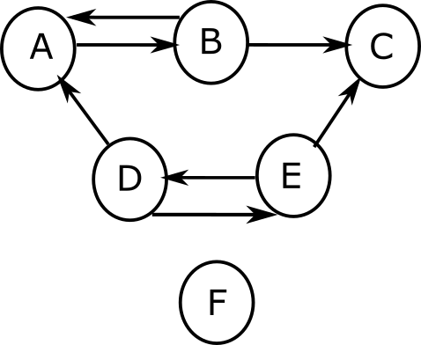
Directed/Undirected Graphs
Ex. Friendship.
Ex. Following.

Slide 16
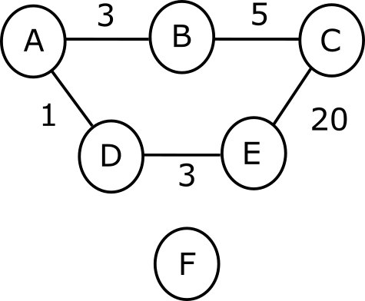
Weighted/Unweighted Graphs
Ex. Crow’s Flight Distance.

Slide 17

Weighted Graphs
Weighted Graphs are mathematically denoted by $G\left(V,E,W\right)$ such that $\left|W\right|=\left|E\right|$.
In our example:
W={3,5,20,3,1}
E={AB,BC,CE,ED,DA}
V = {A,B,C,D,E,F}

Slide 18
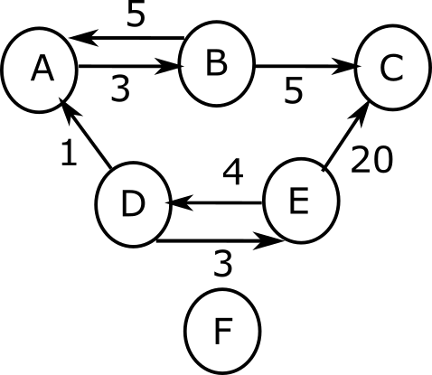
Directed and Weighted
Ex. Highway distance between cities.

Slide 19
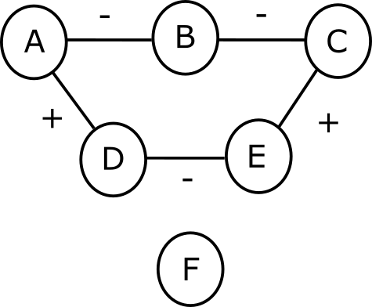
Signed Graphs
Ex. Friendship(+) and Animosity(-).

Slide 20
Path
A path is the sequence of nodes that travel from one node to another without a loop or repetition.
There can be several paths from one node to another.

Slide 21
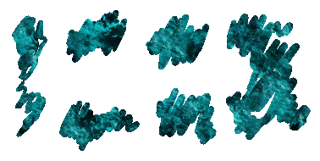
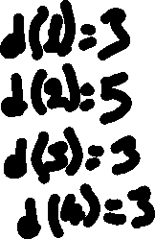
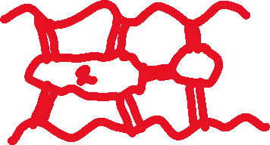


Bridges of Königsberg

Slide 22




Eulerian Walk
In order to pass each edge precisely once, we need one of the following conditions:
All nodes have even degree. OR
Only the start and end nodes have odd degree.

Slide 23

Neighborhood
For each vertex $v_{i}$ the set of all vertices that are connected to $v_{i}$ are called the neighborhood $N\left(v_{i}\right)$ of $v_{i}$.
For graph1:
N(A) = {B,D}
N(B) = {A,C}
N(C) = {B,E}
N(D) = {A,E}
N(E) = {D,C}
N(F) = {}

Slide 24

Neighborhood for Directed Graphs
Now we have to consider both incoming neighbors $N_{in}\left(v_{i}\right)$ and outgoing neighbors $N_{out}\left(v_{\dot{l}}\right)$.
N_{in}(A) = {B,D} and N_{out}(A) = {B}
N_{in}(B) = {A} and N_{out}(B) = {A,C}
N_{in}(C) = {B,E} and N_{out}(C) = {}
N_{in}(D) = {E} and N_{out}(D) = {A,E}
N_{in}(E) = {D} and N_{out}(E) = {D,C}
N_{in}(F) = {} and N_{out}(F) = {}

Slide 25
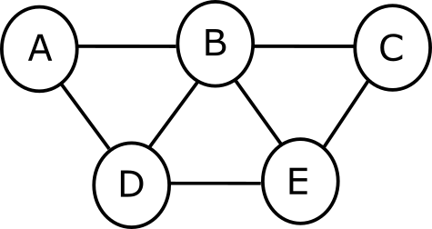
Example
Paths between A and E:
ABE,ADE,ABCE,ADBE,ABDE,
ADBCE
Shortest Paths:
ABE,ADE
All edges are taken as having length 1 in unweighted graphs.

Slide 26
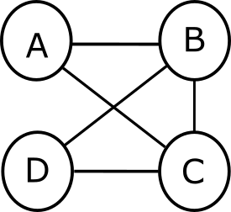
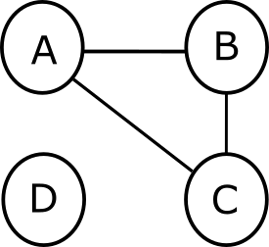
Undirected Graphs: Connected vs. Disconnected
Connected Graph: There is a path from every node to every other node.
Disconnected Graph: Some nodes can’t be reached from all other nodes.

Slide 27
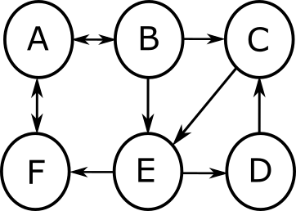
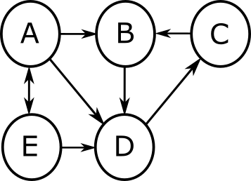
Directed Graphs: Disconnected, Weakly Connected, Strongly Connected
If a path from any node to any other node may be found considering the directions, this is a strongly connected graph.
If a path from any node to any other node may be found only if we ignore the directions, this is a weakly connected graph.
Notes:
No path from D to A if directions are followed.

Slide 28
 | A | B | C | D | E | F
A |  | ✓ | ✓ | ✓ | ✓ | ✓
B | ✓ |  | ✓ | ✓ | ✓ | ✓
C | ✓ | ✓ |  | ✓ | ✓ | ✓
D | ✓ | ✓ | ✓ |  | ✓ | ✓
E | ✓ | ✓ | ✓ | ✓ |  | ✓
F | ✓ | ✓ | ✓ | ✓ | ✓
 | A | B | C | D | E
A |  | ✓ | ✓ | ✓ | ✓
B | ☹ |  | ✓ | ✓ | ☹
C | ☹ | ✓ |  | ✓ | ☹
D | ☹ | ✓ | ✓ |  | ☹
E | ✓ | ✓ | ✓ | ✓

Slide 29


Connected Components
Connected Component
Connected Component,
Also Singleton
Notes:
-Connected components must form a connected graph.
-Subgraph is a more general term, it can include any subset of nodes and edges of a graph.

Slide 30
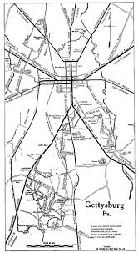

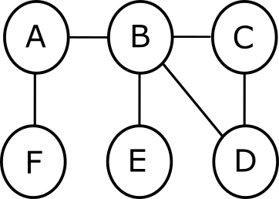


Bridge and Hub
An edge that would separate the graph into connected components if removed is called a bridge.
The node with most connections is called a hub.
Hub
Bridge 1
Bridge 3
Bridge 2

Slide 31
Graph Representation Types

Slide 32
Adjacency Matrix
There can be a 1 at the diagonal only if there is a loop connection from a vertex to itself.
 | A | B | C | D | E | F
A | 0 | 1 | 0 | 1 | 0 | 0
B | 1 | 0 | 1 | 0 | 0 | 0
C | 0 | 1 | 0 | 0 | 1 | 0
D | 1 | 0 | 0 | 0 | 1 | 0
E | 0 | 0 | 1 | 1 | 0 | 0
F | 0 | 0 | 0 | 0 | 0 | 0
For an undirected graph, the adjacency matrix is symmetric along the diagonal.

Slide 33
Adjacency Matrix
 | A | B | C | D | E | F
A | 0 | 1 | 0 | 0 | 0 | 0
B | 1 | 0 | 1 | 0 | 0 | 0
C | 0 | 0 | 0 | 0 | 0 | 0
D | 1 | 0 | 0 | 0 | 1 | 0
E | 0 | 0 | 1 | 1 | 0 | 0
F | 0 | 0 | 0 | 0 | 0 | 0
OUT
IN
For a directed graph, the adjacency matrix may not be symmetric along the diagonal.

Slide 34
Sparse Matrix
Sparse matrix has most of its elements valued 0.
If there is a large number of vertices(nodes) but few connections, the adjacency matrix associated with that graph will be a sparse matrix.
To avoid keeping all values of a sparse matrix most of which are 0, we can use an adjacency list.

Slide 35
Adjacency List
Vertex(node) | Neighbors
A | B,D
B | A,C
C | B,E
D | A,E
E | D,C
F | -

Slide 36
Edge List
Edge
A,B
A,D
B,C
C,E
D,E

Slide 37
Edge List (Directed Graph)
Edge
A,B
B,A
B,C
E,C
D,A
D,E
E,D

Slide 38
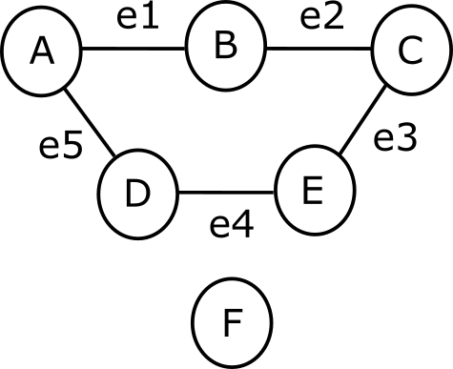
Incidence Matrix
 | e1 | e2 | e3 | e4 | e5
A | 1 | 0 | 0 | 0 | 1
B | 1 | 1 | 0 | 0 | 0
C | 0 | 1 | 1 | 0 | 0
D | 0 | 0 | 0 | 1 | 1
E | 0 | 0 | 1 | 1 | 0
F | 0 | 0 | 0 | 0 | 0
Not suitable for large graphs.

